Slide 1


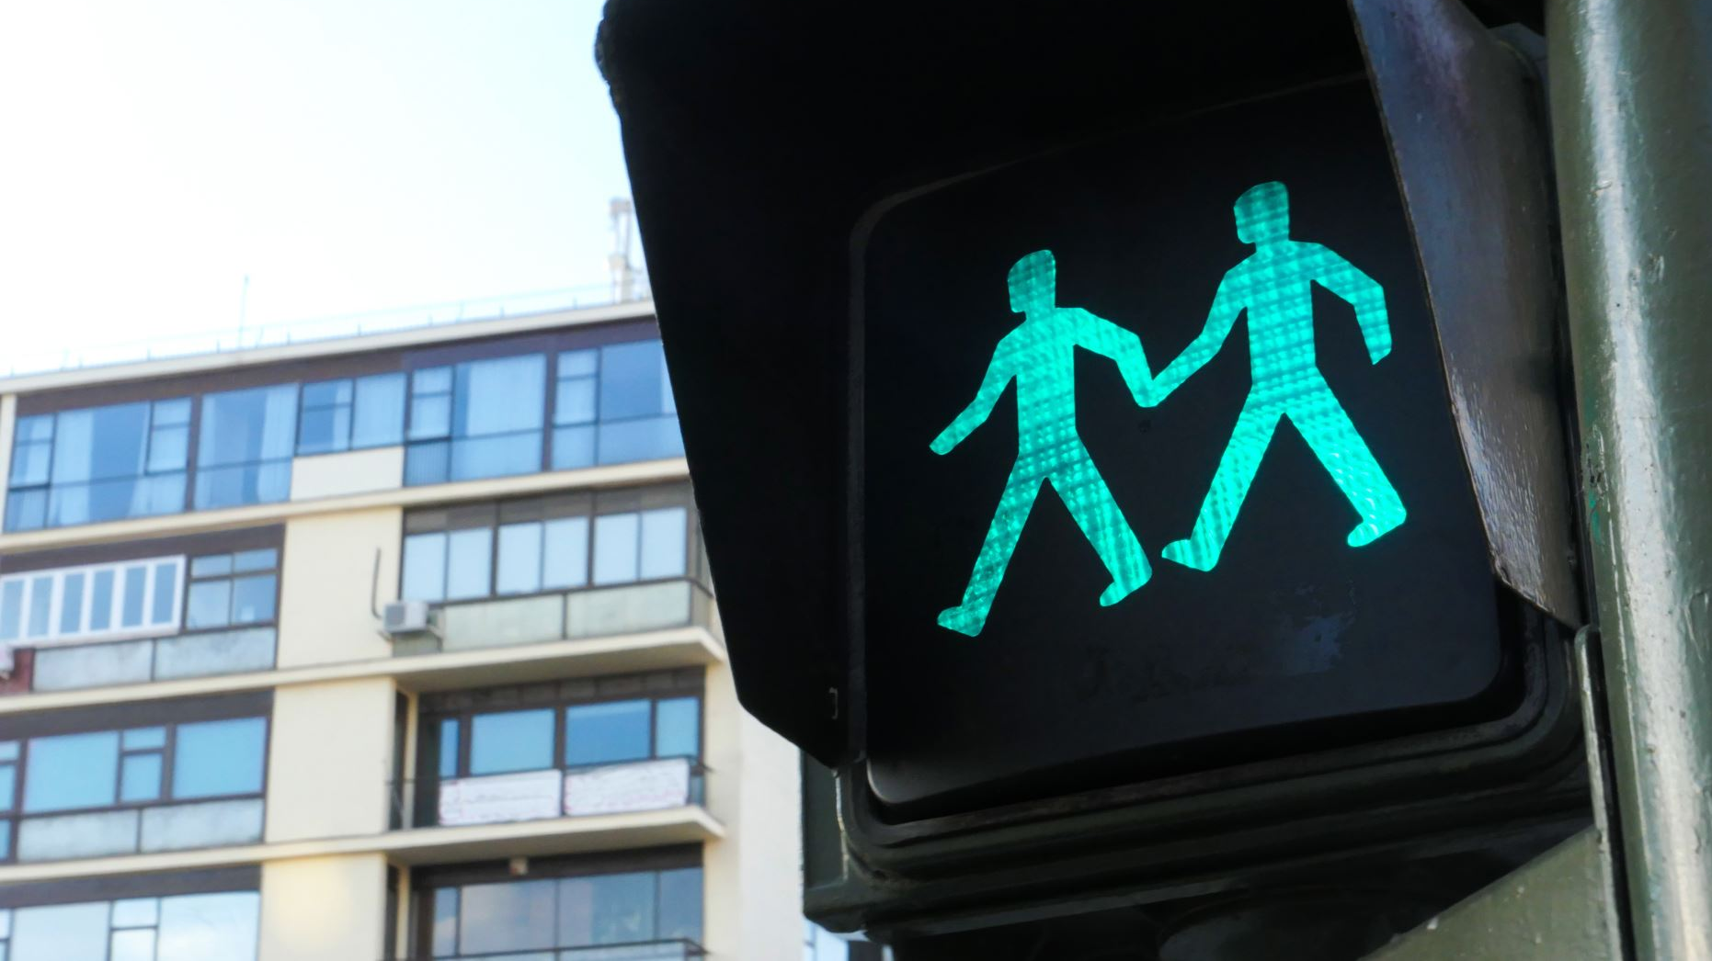



Smart Traffic Intersection Simulation
Comparing Adaptive Signals to Fixed Time Traffic Lights

Slide 2
Team
Muhammad Salman Ali Malik
Coder One
GUI Designer
Muhammad Mujtaba
Coder Two
Simulation Designer
Documenter
Data Analyzer

Slide 3
The Problem
Traffic congestion at intersections is a common issue in urban areas.
Fixed-timed traffic lights often fail to efficiently handle varying traffic volumes.
Adaptive Traffic Lights, while promising, requires resources to implement and put into practice.

Slide 4
Key questions
Can adaptive traffic lights reduce waiting times and improve traffic flow?
1
How do fixed-time lights compare to adaptive lights under different traffic conditions?
2

Slide 5
Proposed Solution
Develop a simulation to compare
Fixed-interval traffic lights
Adaptive traffic lights
Measure and analyze metrics
Average waiting time per vehicle
Queue lengths
Throughput

Slide 6
Key Features
Simulation to test the viability of the Theory
Fixed-time vs adaptive
Measure Waiting time, idle time for each car
Measure Intersection Throughput, Queue Length

Slide 7
Tentative Technical Requirements
C++
GUI
Modular Design

Slide 8
Scope of the Project
In Scope
Fixed and adaptive traffic light algorithms
Metrics comparison
Out of Scope
Pedestrian crossings
AI optimization / machine learning for traffic control

Slide 9
Development Milestones
Design & Planning
Define traffic rules, light algorithms
Prototype Implementation
Implement vehicle generation and movement
Implement traffic lights on an intersection
Analysis & Visualization
Collect basic metrics
Compare fixed vs adaptive results

Slide 10
Conclusion
Aim
Evaluate the efficiency of fixed vs adaptive traffic lights.
Expected outcome
Demonstrate the advantages of adaptive traffic control using simulation.

Slide 11
Have a nice day

